Slide 1
DATA PREPROCESS
學生:林奇鋒

Slide 2
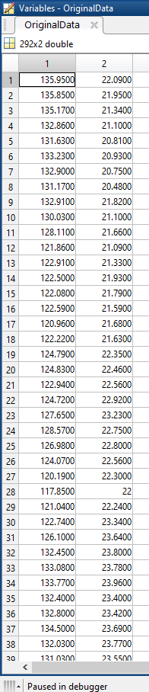
Data
TSMC:2016/01/04~2017/03/01
IBM:2016/01/04~2017/03/01
Ups and Downs : 30

Slide 3
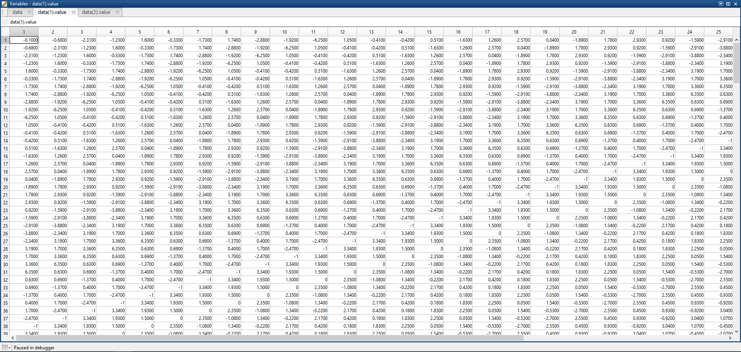
price differences IBM

Slide 4
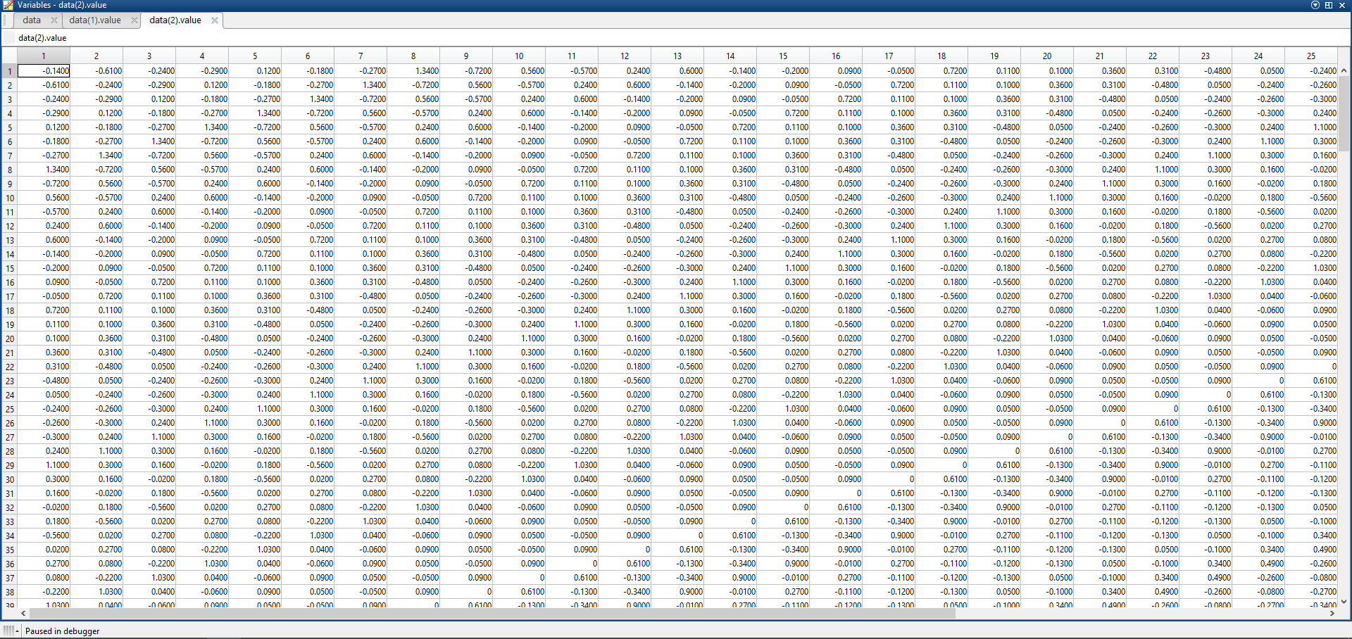
price differences TSMC

Slide 5
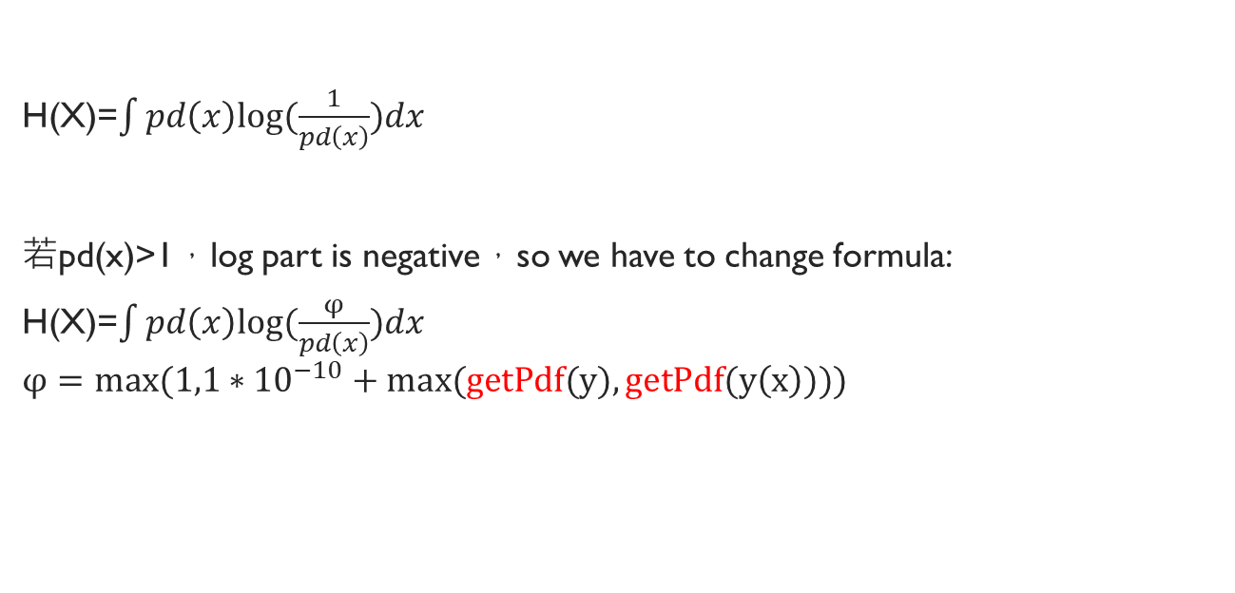
Entropy
H(X)=$\int{pd\left(x\right)log⁡(\frac{1}{pd\left(x\right)})dx}$
若pd(x)>1，log part is negative，so we have to change formula:
H(X)=$\int{pd\left(x\right)log⁡(\frac{φ}{pd\left(x\right)})dx}$
$$φ=max(1,1∗{10}^{−10}+max(getPdf(y),getPdf(y\left(x\right))))$$

Slide 6

$getPdf$(data)
pd=fitdist(data,'kernel');
range=linspace(pd.mean-5*pd.std,pd.mean+5*pd.std,500);
output=pdf(pd,range);

Slide 7
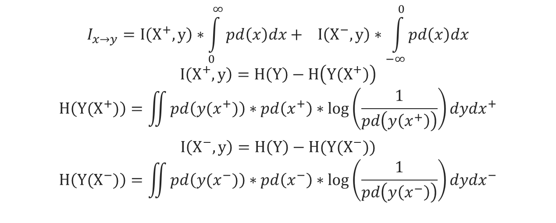
Mutual Information:
$$I_{x→y}=I\left(X^{+},y\right)∗\int_{0}^{∞}{pd\left(x\right)dx}+ I\left(X^{−},y\right)∗\int_{−∞}^{0}{pd\left(x\right)dx}$$
$$I\left(X^{+},y\right)=H\left(Y\right)−H\left(Y\left(X^{+}\right)\right)$$
$$H\left(Y(X^{+})\right)=\iint{pd\left(y(x^{+})\right)∗pd\left(x^{+}\right)∗\log\left(\frac{1}{pd\left(y\left(x^{+}\right)\right)}\right)dydx^{+}}$$
$$I\left(X^{−},y\right)=H\left(Y\right)−H(Y(X^{−}))$$
$$H\left(Y(X^{−})\right)=\iint{pd\left(y(x^{−})\right)∗pd\left(x^{−}\right)∗\log\left(\frac{1}{pd\left(y\left(x^{−}\right)\right)}\right)dydx^{−}}$$

Slide 8
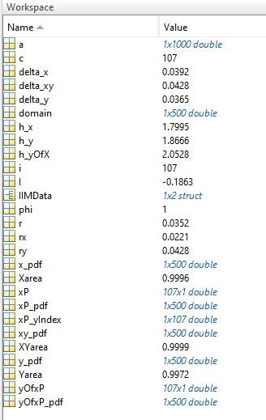
pdf

Slide 9
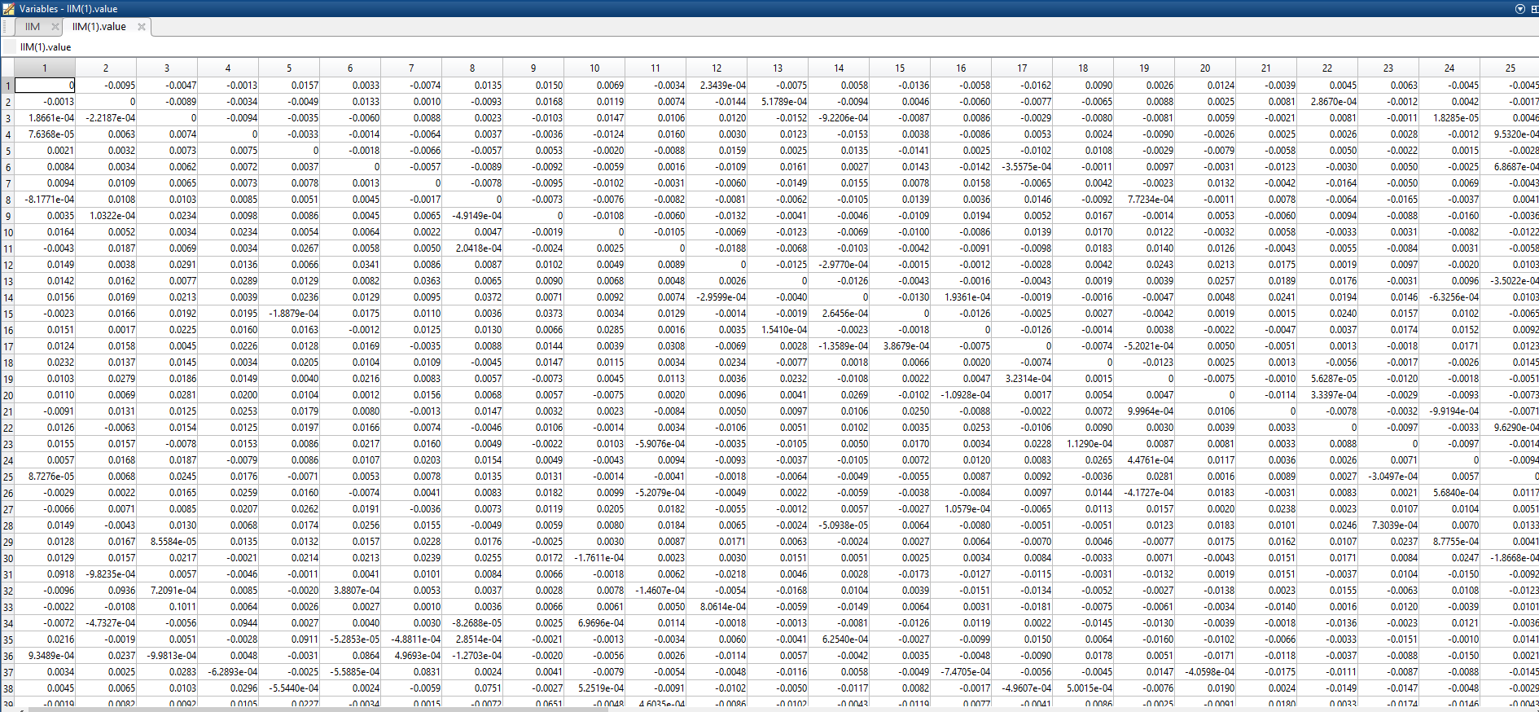
IIM

Slide 10



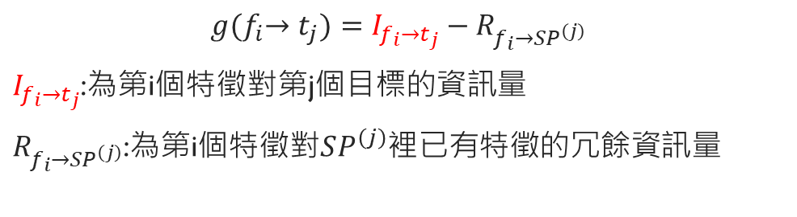






Feature selection
$$g{(f}_{i}→t_{j})=I_{f_{i}→t_{j}}−R_{f_{i}→SP^{\left(j\right)}}$$
$I_{f_{i}→t_{j}}$:為第i個特徵對第j個目標的資訊量
$R_{f_{i}→SP^{\left(j\right)}}$:為第i個特徵對$SP^{\left(j\right)}$裡已有特徵的冗餘資訊量
$$f_{1}$$
$$f_{2}$$
$$f_{3}$$
61
$$f_{1}$$
$$I_{f_{1}→t_{1}}$$
$$f_{2}$$
$$I_{f_{2}→t_{1}}$$
$$f_{60}$$
$$I_{f_{60}→t_{1}}$$

Slide 11










Feature selection
$$g{(f}_{1}→t_{1})=I_{f_{1}→t_{1}}−R_{f_{1}→SP^{\left(1\right)}}$$
$$g{(f}_{1}→t_{2})=I_{f_{1}→t_{2}}−R_{f_{1}→SP^{\left(2\right)}}$$
$SP^{\left(1\right)}=${$f_{49}$ }
$SP^{\left(2\right)}=${$f_{23}$ }
$$R_{f_{1}→SP^{\left(1\right)}}=(I_{f_{1}→f_{49}}+I_{f_{49}→f_{1}})/2$$
$$R_{f_{1}→SP^{\left(2\right)}}=(I_{f_{1}→f_{23}}+I_{f_{23}→f_{1}})/2$$
$$g{(f}_{1}→t_{1})>0$$
$$g{(f}_{1}→t_{1})<0$$
$SP^{\left(1\right)}=${$f_{49}$ $f_{1}$}
$SP^{\left(2\right)}=${$f_{23}$}

Slide 12
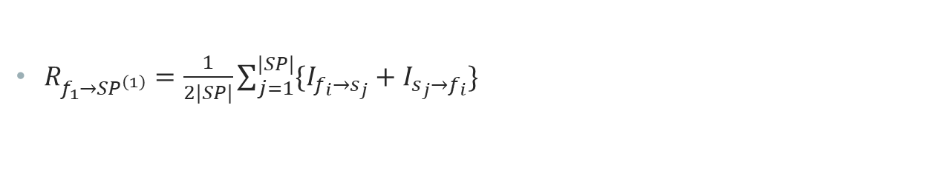
Redundancy
$R_{f_{1}→SP^{\left(1\right)}}=\frac{1}{2|SP|}\sum_{j=1}^{|SP|}{\{I_{f_{i}→s_{j}}+I_{s_{j}→f_{i}}\}}$

Slide 13
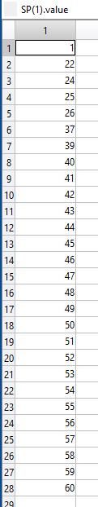
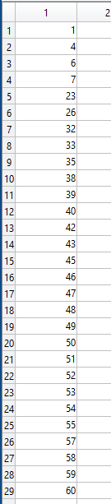
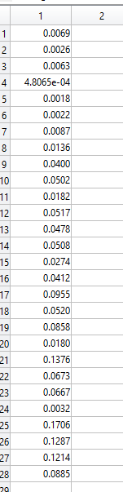
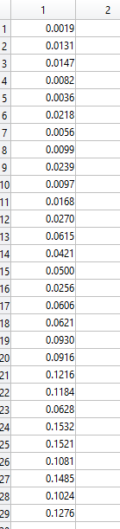




$$SP^{\left(1\right)}$$
$$g{(f}_{i}→t_{1})$$
$$SP^{\left(2\right)}$$
$$g{(f}_{i}→t_{2})$$

Slide 14
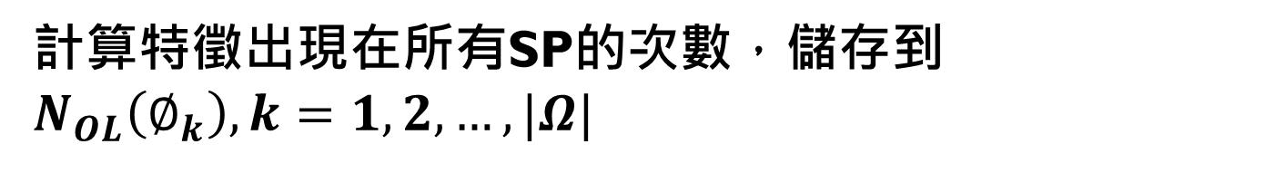

將所有SP中出現過的特徵記錄下來，儲存成$Ω$，$Ω=\{∅_{k},k=1,2,…,|Ω|\}$
計算特徵出現在所有SP的次數，儲存到$N_{OL}\left(∅_{k}\right),k=1,2,…,|Ω|$

Slide 15
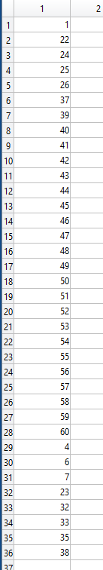
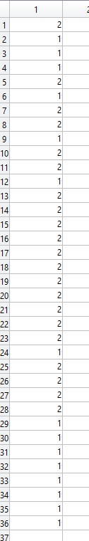




$$N_{OL}$$
$$SP^{\left(1\right)}$$
$$SP^{\left(2\right)}$$
$$Ω$$

Slide 16

有了次數後即可計算覆蓋率$ω$，公式如下:
$ω\left(∅_{k}\right)=\frac{N_{OL}\left(∅_{k}\right)}{|TS|} ,k=1,2,…,|Ω|$
當中$|TS|$為目標個數

Slide 17
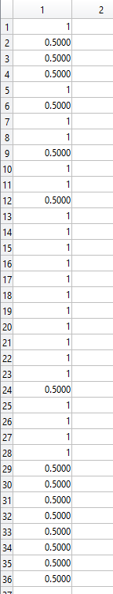



$$N_{OL}$$
$$Ω$$
$$ω$$

Slide 18

累加每個SP裡，特徵的增益量:
$$g_{sum}\left(∅_{k}\right)=\sum_{j=1}^{|TS|}{g(∅_{k}→t_{j})},k=1,2,…,|Ω|$$

Slide 19
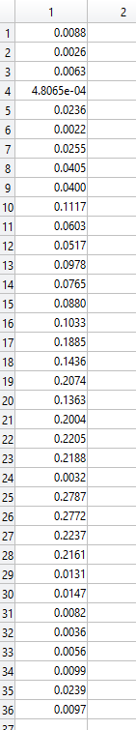





$$SP^{\left(1\right)}$$
$$g{(f}_{i}→t_{1})$$
$$SP^{\left(2\right)}$$
$$g{(f}_{i}→t_{2})$$
$$Ω$$
$$g_{sum}$$

Slide 20

根據累加後的資訊增益量$g_{sum}$和覆蓋率$ω$，計算出目標的總貢獻量$ρ$
$ρ\left(∅_{k}\right)=ω\left(∅_{k}\right)∗g_{sum}\left(∅_{k}\right),k=1,2,…,|Ω|$

Slide 21
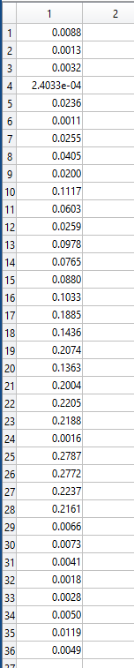




$$Ω$$
$$ω$$
$$g_{sum}$$
$$ρ$$

Slide 22

如果特徵計算出的總貢獻量$ρ(∅_{k})$大於平均總貢獻量，即可挑選該特徵來當訓練資料

Slide 23
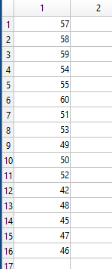





$$Ω$$
$$ω$$
$$g_{sum}$$
$$ρ$$
$\overline{ω}$=0.7895
$\overline{g_{sum}}$=0.0925
Threshold=0.073
$$Qualified$$

Slide 24


$$Qualified$$
$F$P

